Slide 1
Unique Corns
Parth Champaneri, Allen Hsiao, Clare Kim,
Pascal Queeney, Patrick Tan

Slide 2
The theme of CHI 2019 is ‘Weaving the threads’. In the Student Design Competition, we encourage you to contribute to this theme by considering the ways that technology might be used to strengthen our social fabric

Slide 3

General Protocol
Participants performed various tasks:
Logging in, importing schedule, looking at profile
Finding and joining an event
Creating event
Metrics:
Amount of time spend to complete each task
Number of erroneous taps
Note difficulties, being stuck
SUS (System Usability Scale)

Slide 4


Result of experiment
Challenges via Axure RP
Pop-ups sometimes appear outside of view
Scaling problems on mobile
Very niche cases
Usability Testing Findings
Unsure how to manage threads
Badges seemed irrelevant
Only able to “upload” schedule
On map, can only see quick view events
Some functionalities not implemented yet
No clear explanation of “threads”

Slide 5
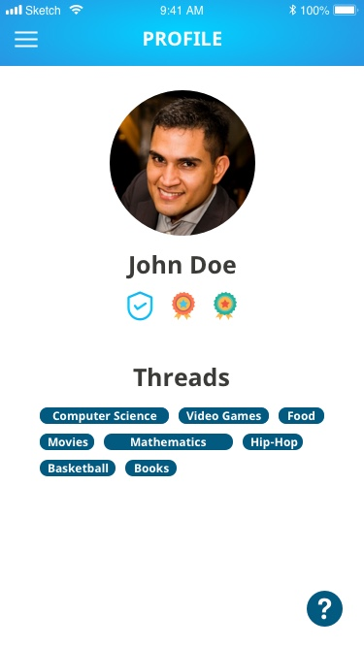
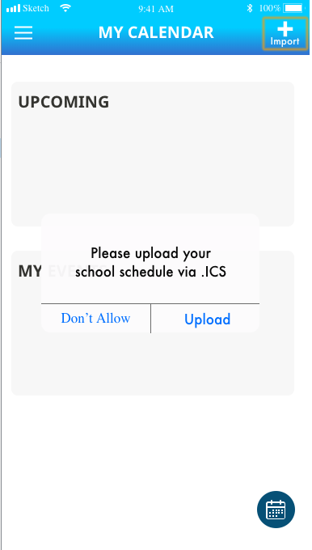
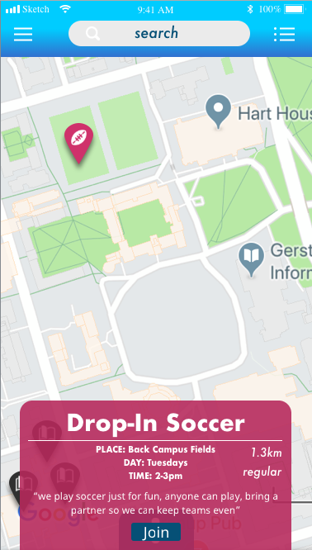

Slide 6

Result of experiment
Likes:
Navigation was a slight a problem
User can navigate between screens easily
Symbols and menu are recognizable
Finding and exploring events
Quick peek
Detailed view
Badges
Real-time status (success, errors)

Slide 7
SUS Results
I think that I would like to use this system frequently.
I found the system unnecessarily complex.
I thought the system was easy to use.
I think that I would need the support of a technical person to be able to use this system.
I found the various functions in this system were well integrated.
I thought there was too much inconsistency in this system.
I would imagine that most people would learn to use this system very quickly.
I found the system very cumbersome to use.
I felt very confident using the system.
I needed to learn a lot of things before I could get going with this system.

Slide 8
SUS Results
I think that I would need the support of a technical person to be able to use this system
I thought there was too much inconsistency in this system.
I felt very confident using the system.

Slide 9
Conclusion of design
Overall navigation and use of the application can be a little complicated for some
Need to tweak on the functionality from the prototype for the final product
The design should clearly distinguish different event availability (colour-coded)
Push notification
More control for “create-an-event”

Slide 10

Future work
Refine
Get as close to a “real” product
Build upon “strengthen the social fabric”
More interactivity within profile
More profile options
Social media integration
Help and Settings
Tutorial prompt w/ First time user
Discussion Board
Feedback and comments
Research
How does it compare to other services
Other schools
Mobile application or website?

Slide 11
Questions

